Slide 1
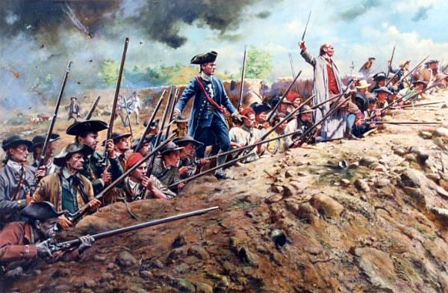
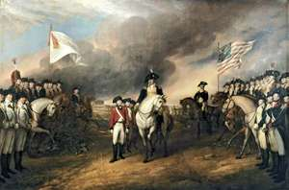
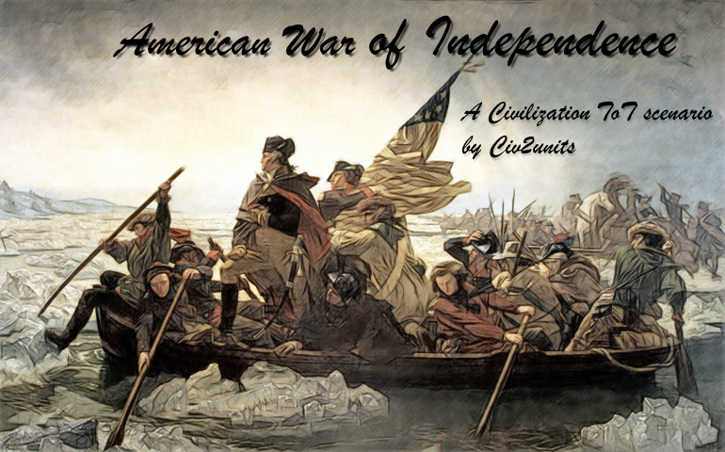
American War of Independence
1776 – 1783

Slide 2
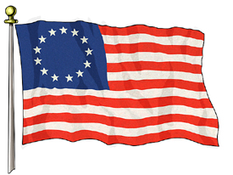
Battle Sites & Major Events of the War of Independence
1775 – Lexington & Concord - 2nd Continental Congress - Olive Branch Petition - Appointment of Washington as Commander-in-Chief - Battle of Bunker Hill
1776 – Battles of New York 1777 - Battle of Princeton - Battle of Saratoga - Winter at Valley Forge
1778 – France, Spain & Netherlands join the American cause
1779 –
1780 –
1781 – Battle of Yorktown & British Surrender
1783 – Treaty of Paris

Slide 3
Battle of Lexington & Concord
1775

Slide 4
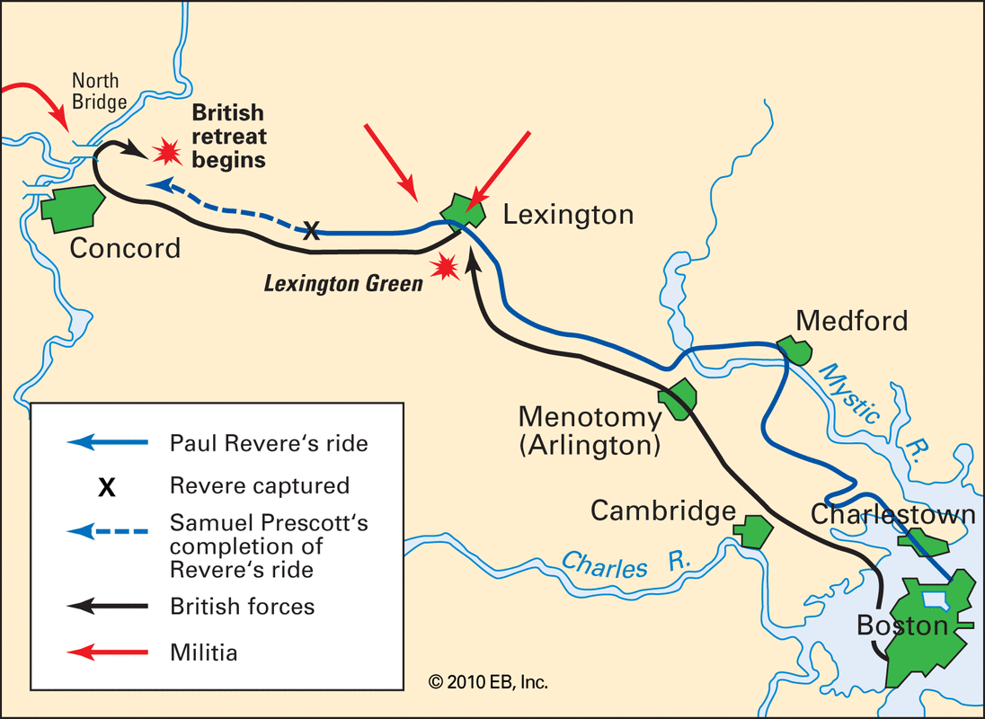
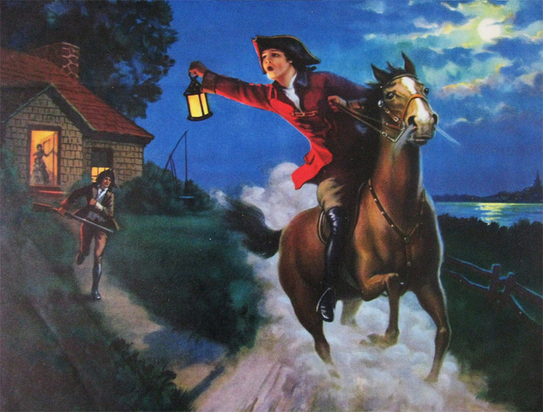
1: Battle of Lexington & Concord (1775)
British Aim: - To take control of munitions store in Concord
- To arrest John Adams & John Hancock
American Response: - Paul Revere rode to Lexington warning the minutemen that the British were coming to take and destroy arms at Concord.
“The British are coming!”

Slide 5
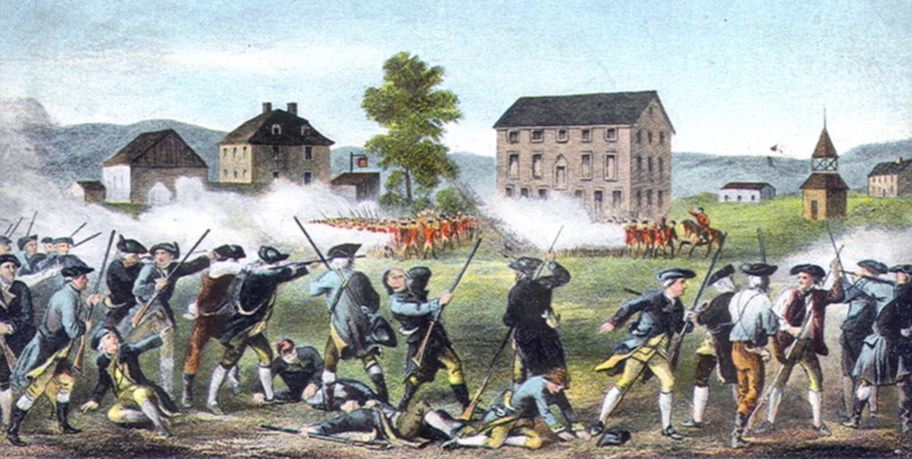
1: Battle of Lexington & Concord (1775)
The British marched all night and were met by American minutemen militia at Lexington. Here the British commander demanded that they disperse.
The American minutemen were instructed:
“Do not fire unless fired upon…but if they mean to have a war, let it begin here!”
It is not certain who fired the first shot, but it is believed to have been the British.
8 minutemen were dead at the end of the battle.

Slide 6
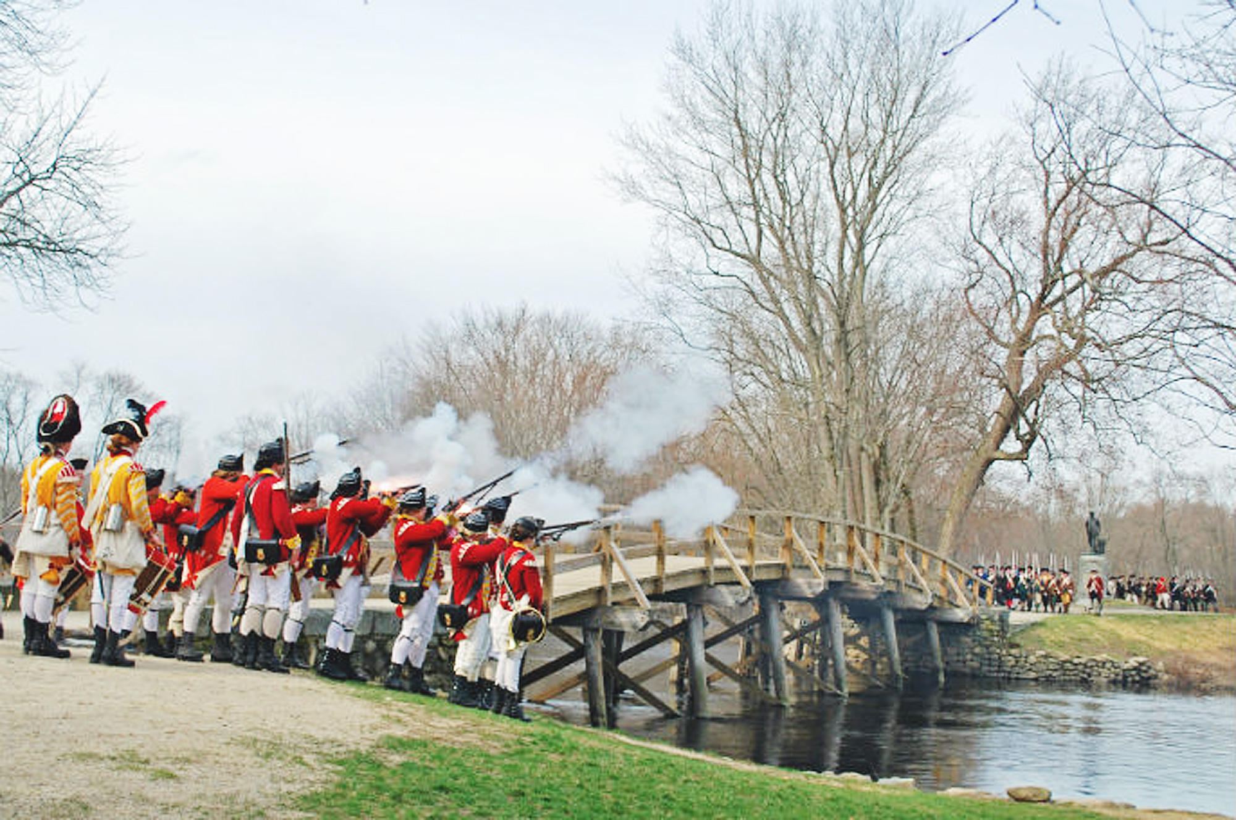
1: Battle of Lexington & Concord (1775)
The British continued their march towards Concord, while being fired at by militiamen from the cover of trees and from behind stone walls.
At the Old North Bridge, the British troops were met by 400 militiamen.
The British retreated from the bridge as they were outnumbered.
The Americans continued to snipe at and ambush the British troops as they retreated towards Lexington and Boston

Slide 7
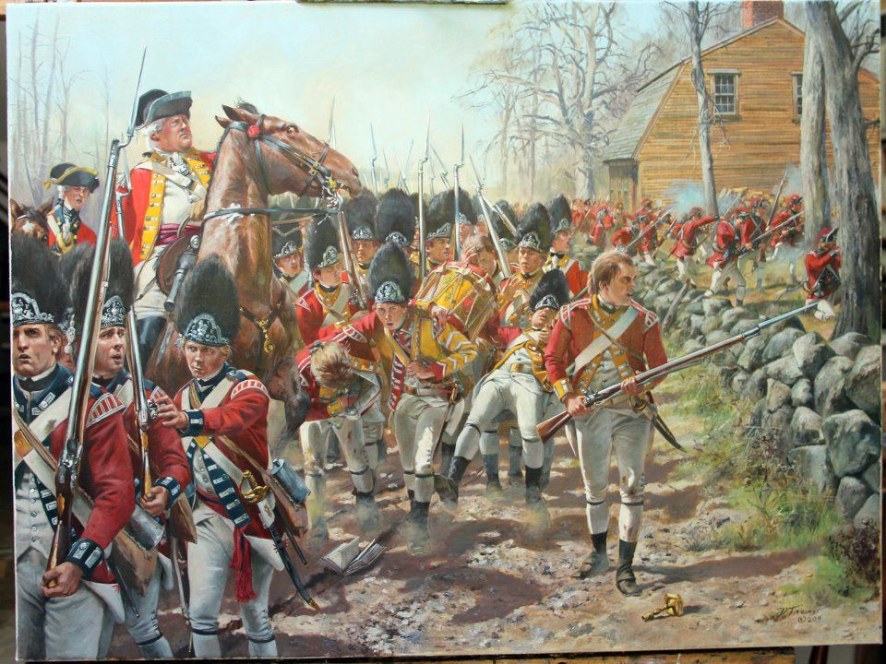
1: Battle of Lexington & Concord (1775)
When the British arrived at Concord, they were surprised by an American ambush just outside the town
The British were forced to retreat to Boston
.
The War of Independence had begun.
“The shots heard around the world”
Video: Battles of Lexington & Concord

Slide 8
2nd Continental Congress (1775)

Slide 9
2nd Continental Congress (1775)
Met to discuss peace initiatives
Drafted the Olive Branch Petition to be sent to King George: this was a letter to be sent to the King asking for a compromise to be struck to end hostilities.
Appointed George Washington as Commander-in-Chief of the Continental Army.
The King’s response to the Olive Branch Petition was to reject it out of hand.
Debate on Olive Branch Petition
King George's Response to Olive Branch Petition

Slide 10
Patrick Henry, a delegate from Virginia, made a stirring speech when the Americans were confronted with King George’s demand that their forces disperse and their congress disband:
“Give me liberty; or give me death!”
https://www.youtube.com/watch?v=DbghWFMLyiA

Slide 11
American Continental Army
The 2nd Continental Congress established a Continental Army that was commanded by George Washington
This organized the militia into an official army
Appointment of Washington as Commander-in-Chief
Notes:
The Americans needed an actual army (minutemen weren’t really the best plan of action), and they named George Washington as commander. He had become a war hero during the French and Indian War, and he was very respected by all of the colonial leaders.

Slide 12
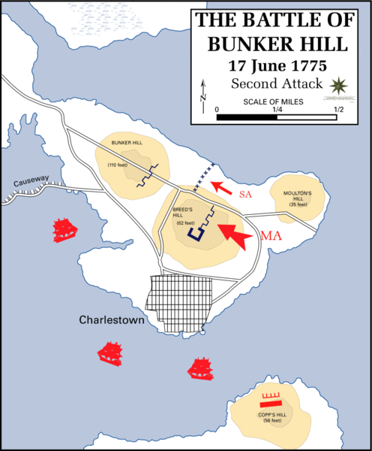
2: Battle of Bunker Hill (1775)
The British Army were due to take control of a number of hills surrounding Boston. American militiamen positioned themselves to prevent this.
They fought the British to a standstill on Breed’s Hill. The British had to charge the hill three times, before the Americans retreated.
Even though the British won the battle, they did so at the cost of 1,000 men. Also, the American soldiers were ordered to target the British Officers first and foremost.
It was an important morale boost for the inexperienced and poorly-equipped American Army: “Don’t fire until you see the whites of their eyes”
Battle of Bunker Hill

Slide 13
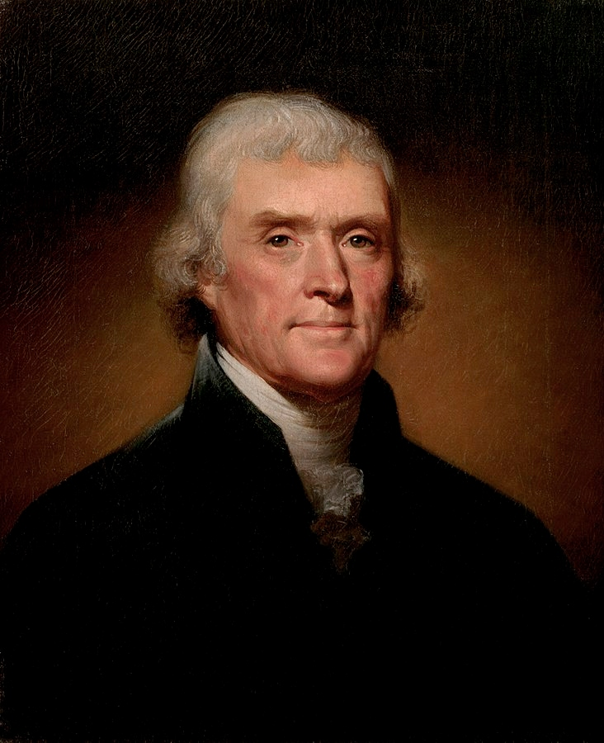
Declaration of Independence (1776)
“We hold these truths to be self-evident, that all men are created equal, that they are endowed by their Creator with certain unalienable Rights, that among those are Life, Liberty, and the pursuit of Happiness.”

Slide 14
Declaration of Independence
On 4th July, 1776, 12 of the 13 American Colonies voted to adopt the draft Declaration of Independence, written by Thomas Jefferson.
Only New York abstained on its vote.
“We hold these truths to be self-evident, that all men are created equal, that they are endowed by their Creator with certain unalienable Rights, that among those are Life, Liberty, and the pursuit of Happiness.”

Slide 15
"When in the Course of human events, it becomes necessary for one people to dissolve the political bands which have connected them with another, … the separate and equal station to which the Laws of Nature and of Nature's God entitle them, a decent respect to the opinions of mankind requires that they should declare the causes which impel them to the separation."
"That to secure these rights, Governments are instituted among Men, deriving their just powers from the consent of the governed…”
“But when a long train of abuses and usurpations, pursuing invariably the same Object evinces a design to reduce them under absolute Despotism, it is their right, it is their duty, to throw off such Government, and to provide new Guards for their future security."
“The history of the present King of Great Britain is a history of repeated injuries and usurpations, all having in direct object the establishment of an absolute Tyranny over these States.”
“That these united Colonies are, and of Right ought to be Free and Independent States; that they are Absolved from all Allegiance to the British Crown, and that all political connection between them and the State of Great Britain, is and ought to be totally dissolved.”
“A Prince, whose character is thus marked by every act which may define a Tyrant, is unfit to be the ruler of a free people."

Slide 16
Benjamin Franklin
Author, theorist, politician, scientist, writer and inventor.
Representative of Pennsylvania
Sent to France to convince them to help the Americans in the revolution with soldiers, supplies, and ships
Notes:
Bonus question: What is Benjamin Franklin famous for doing/telling the colonies to do during the French and Indian War? (Answer: Join or die! Join together to fight the French or lose is separated.)
He now knows that the colonies need help, and he knows that no one hates Great Britain more than the French…so he asks them to help the colonists in the war effort. The French refuse to help, but they are very interested in the success of the Americans…if they win, then England will no longer be the most powerful country in the world.

Slide 17
Tactical Comparisons
List three relative strengths of the American Colonial Army
List three relative weaknesses/ disadvantages of the American Colonial Army

Slide 18
Tactical Comparisons
List three relative strengths of the American Colonial Army
List three relative weaknesses/ disadvantages of the American Colonial Army
Fighting on home territory (evasion, ambush, local knowledge, supporters etc.)
Excited about the prospect of independence
Large population to draw on
Inexperienced / part-time
Poorly-equipped
No navy

Slide 19
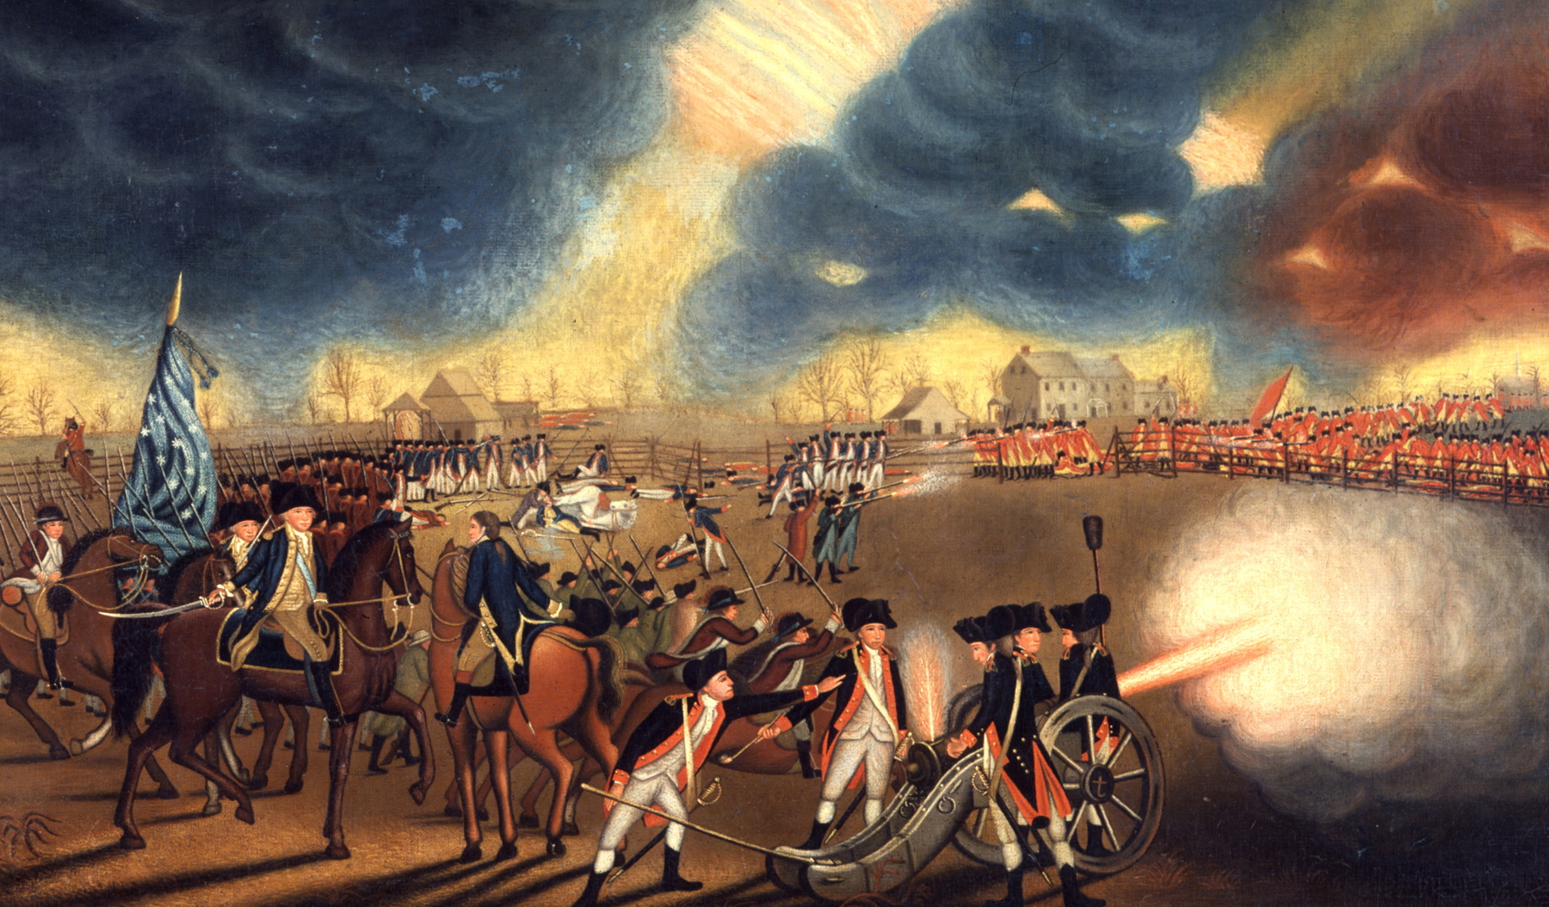
Battles of New York, Trenton & Princeton (1776 - 1777)
Battle of New York (1776): British Victory & American Retreat
Battle of Trenton (1776): American victory with the capture of German mercenaries (Hessians)
Battle of Princeton (1777): Washington evades Cornwallis and defeats British rearguard

Slide 20
Crossing the Delaware (1776)
On the night of 25-26th December, Washington crossed the freezing Delaware river with 4,200 men and artillery in preparation for the attack on Trenton
Crossing the Delaware

Slide 21
Battle of Saratoga (Sept. – Oct. 1777)
American General Gates defeated a British army of 8,000 redcoats
Huge morale boost for the American Army
Considered to be a major turning point in the war
Encouraged the French, Spanish and Dutch to join the war in support of the Americans.

Slide 22
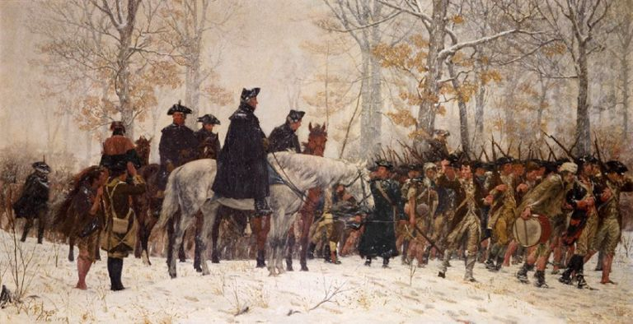
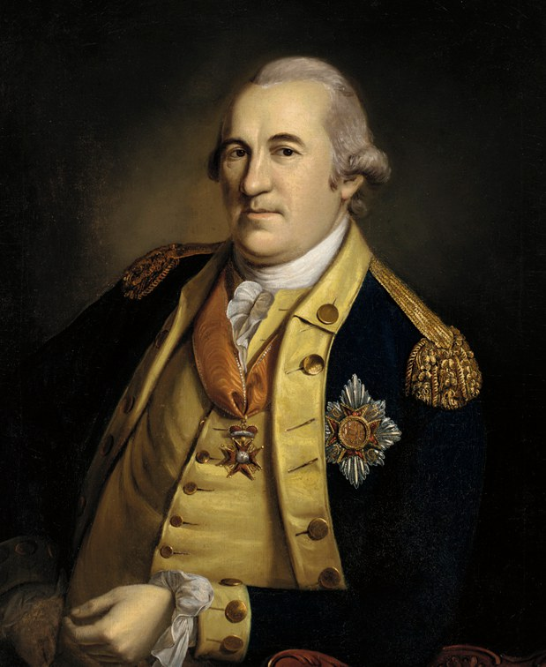
Winter at Valley Forge: General Von Steuben & Marquis de Lafayette
In the winter of 1777-1778, Washington camped with his men in Valley Forge.
The men were exhausted, their equipment poorly maintained and low on food and supplies.
A Prussian officer, General Von Steuben, was given the task of training the men in battle discipline and tactics.
Although many men suffered and died (1/4 of the men) during this winter, Von Steuben helped to create a disciplined, modern army capable of taking on the British.
De Lafayette spent the winter at Valley Forge also, an enthusiastic supporter of the Americans. He paid soldiers from his own money

Slide 23
French Navy slows British Response
The French Navy helped to critically delay and disrupt the British response to American efforts.

Slide 24
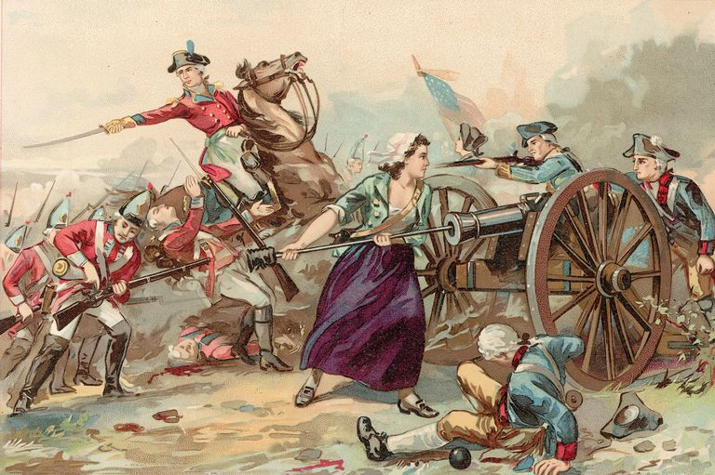
Notable Operatives & Supporters
Thomas Paine
Revolutionary Writer: ‘Common Sense’
“An island cannot rule a continent”
Donated profits from his books to the American Army
Mary Hayes McCauley, became famous as a nurse tending to the American soldiers on the battlefield.
When her husband collapsed from heat exhaustion, she took his place, loading and preparing cannons for firing.
James Armistead, a freed slave, worked as a spy for the Americans under the guidance of the Marquis de Lafayette

Slide 25
Battle of Yorktown (1781)
The French fleet arrived 6 hours before the British Navy, blocking Cornwallis’ chance of escape
3 Groups of American soldiers surrounded the British position
The British suffered their final defeat at the Battle of Yorktown, where General Cornwallis’ troops surrendered to the Americans, bringing the War of Independence to an end.
British Defeat & Surrender

Slide 26
British Surrender at Yorktown (1781)
Washington and his generals surrounded Yorktown on 3 sides with 17,000 men
French Navy blocked any attempts at escape or reinforcement
Using diversionary attacks, the British were overwhelmed and forced to surrender.
Formal surrender was signed on October 19th, 1781.

Slide 27
The Treaty of Paris (1783)
The Treaty of Paris was signed in 1783, bringing a formal end to the American Revolution
Britain now recognized the independence of the USA

Slide 28
Battle of Lexington & Concord (1775)
Creation of the American Revolutionary Army under the command of George Washington
2nd Continental Congress (1775)
Olive Branch Petition (1775)
1775
1775
1775
1776
1776
1777
1778

