Slide 1
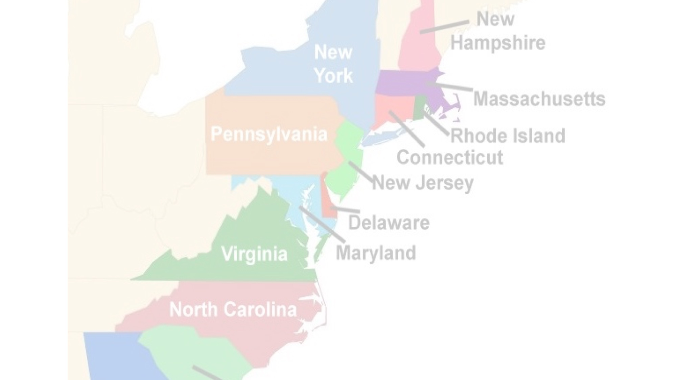
The 13 Colonies

Slide 2
Objectives
Identify the origins (dates) of the founding of each of the 13 Colonies
Classify their foundation – Colonization
Describe & categorise the settlers of these 13 Colonies
Describe the power relationships between settlers & European countries
Examine the conflict between European powers over ownership of the ‘New World’
Describe the outcomes of these conflicts
Examine how these outcomes affected / changed the relationship between the 13 Colonies and Britain

Slide 3
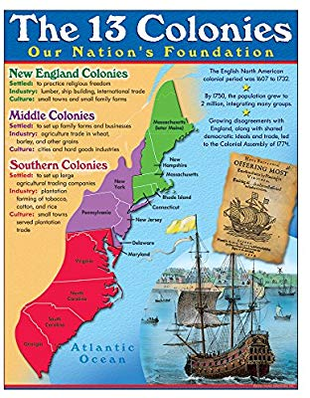
The Thirteen Colonies
Virginia (1607) – founded by Captain John Smith (settlers fleeing strict rule of King of England)
Massachusetts (1620) – founded by John Carver & settled by Puritan pilgrims (Thansgiving)
Maryland (1634) George Calvert (charter of religious freedom* - opposed by King Charles I)
Rhode Island (1636) founded by Roger Williams – who was opposed to Puritanism and advocated religious tolerance.
Conneticut (1636) founded by Thomas Hooker – freedom of religion
North Carolina (1663) originally founded by English nobles, later split into North & south Carolina
South Carolina (1729) – after split from North Carolina

Slide 4
The Thirteen Colonies
New York (1609) – originally called ‘New Netherland’ became New York in
1664
New Hampshire (1679) established as a Royal Colony with King choosing governor and no elected government
Pennsylvania (1681) founded by William Penn – freedom of religion & right to elect public officials
Delaware (1704) – also founded by William Penn
New Jersey (1702) – originally two – East & West Jersey
Georgia (1733) – founded by James Oglethorpe for ex-convicts and a buffer zone between Spanish & English colonies

Slide 5
Colonization Process – Mercantilism
Mercantilist Theory
Rationale for Colonization
At the heart of the colonization of the New World by English settlers was the ideology and practice of Mercantilism
Mercantilism – “the economic theory that trade generates wealth and is stimulated by the accumulation of profitable balances, which a government should encourage by means of protectionism.”
Create trading colonies (mercantilism)
Relieve excess population
Provide new settlements for religious refugees

Slide 6
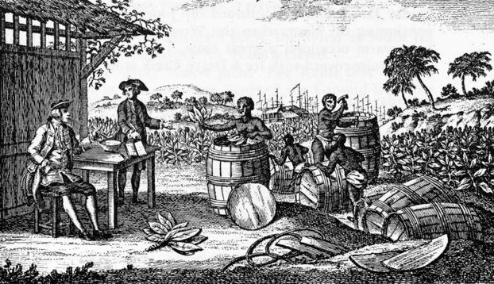
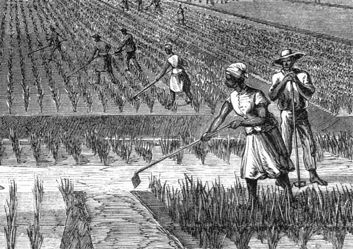
Plantations
Tobacco Plantation
Rice Plantation

Slide 7
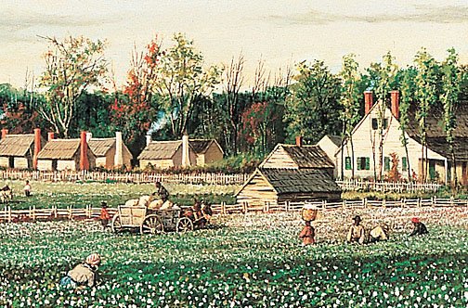
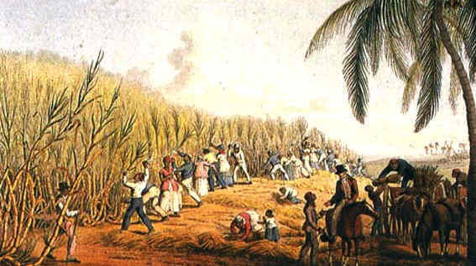
Plantations
Cotton Plantation
Sugar Cane Plantation

Slide 8
Review Questions
What is Mercantilism’?
Why would Britain invest in colonies in the New World?
What is the common feature between all four images on Slides 6 & 7?

Slide 9
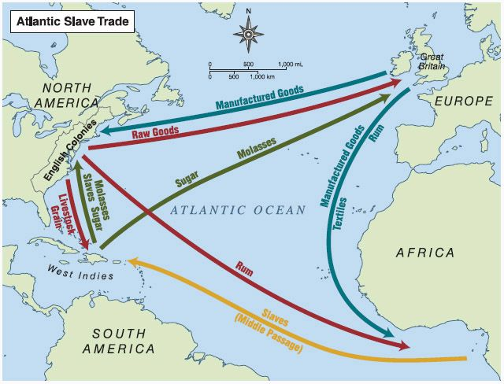
The Triumvirate Economic Relationship:
Europe – Africa - America
Raw goods from America to Britain
Manufactured Goods from ______ to ________
Manufactured Goods from _________ to _________
Sugar & Molasses from _________ to __________
____________ from Africa to West indies.
_____________ , ___________ & ___________ from West Indies to America.
Livestock & Grain from __________ to ___________

