Slide 1
The 13 Colonies
The Costs of Victory & Ownership: Revolution Stirs

Slide 2
Background to Revolution
1754 – 1763 – French & Indian War (part of a global war fought between Britain and France)
A dispute erupted over who would control the land surrounding the Ohio River

Slide 3
The Ohio River Valley
The land surrounding the Ohio River was critical to both British & French traders and merchants
There were also many disputes surrounding the ownership of the Great Lakes
The French dominated the region with alliances with Native Americans

Slide 4
Territorial Outcomes of French & Indian War
Who lost territory and who gained territory as a result of the Nine Years’ War?
How would this change have affected British policy in the American Colonies?

Slide 5
Increased Costs of British Army Presence in America
King George III was an unpredictable monarch.
He refused to allow colonists to have representation in parliament and did not respond to their complaints
He felt that the colonists should pay for the significant cost of the British Army protection in America. This had been paid for by British taxes during the French & Indian War.
Throughout all this, Britain set out to impose protectionist policies and tight regulations on American Colonists’ exports to recover costs of the war.

Slide 6
The Cost of the Seven Years’ War
Even though Britain emerged victorious from the Seven Years’ War (in Europe) and the French & Indian War (America), Britain’s debt rose sharply – up to 140 million Pounds Sterling!
How much would that be in today’s money?

Slide 7
Taxation of Colonies
The British decided to recoup the costs of all this military expenditure by introducing heavy taxes and strictly regulating American exports.
1765 (The Stamp Act) - a tax on written documents, e,g. wills, marriage certificates, newspaper ads, etc.
1767 (The Townshend Acts) - a tax on oil, tea, glass, paint & paper
1774 (The Intolerable Acts) - a series of repressive acts aimed at bringing the colonists under control and to counteract protests, smuggling and unrest

Slide 8
The Townshend Act (Foreword)
“AN ACT for granting certain duties in the British colonies and plantations in America; for allowing a drawback of the duties of customs upon the exportation from this kingdom, of coffee and cocoa nuts of the produce of the said colonies or plantations; for discontinuing the drawbacks payable on china earthen ware exported to America; and for more effectually preventing the clandestine running of goods in the said colonies and plantations.”
Q. What was Britain trying to prevent by the imposition of this tax?

Slide 9
The Intolerable Acts: The Boston Port Act
“AN ACT to discontinue, in such manner, and for or such time as are therein mentioned, the landing and discharging, lading or shipping, of goods, wares, and merchandise, at the town, and within the harbour, of Boston, in the province of Massachuset's Bay, in North America.”
Q. Give one reason why the British Government might impose the controls stated above.

Slide 10
The Colonists’ Response
Boston Massacre (1770)
Boston Tea Party (1773)

Slide 11
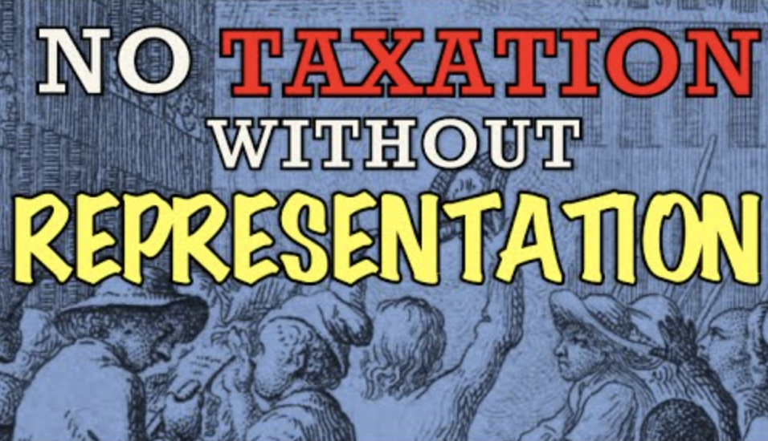
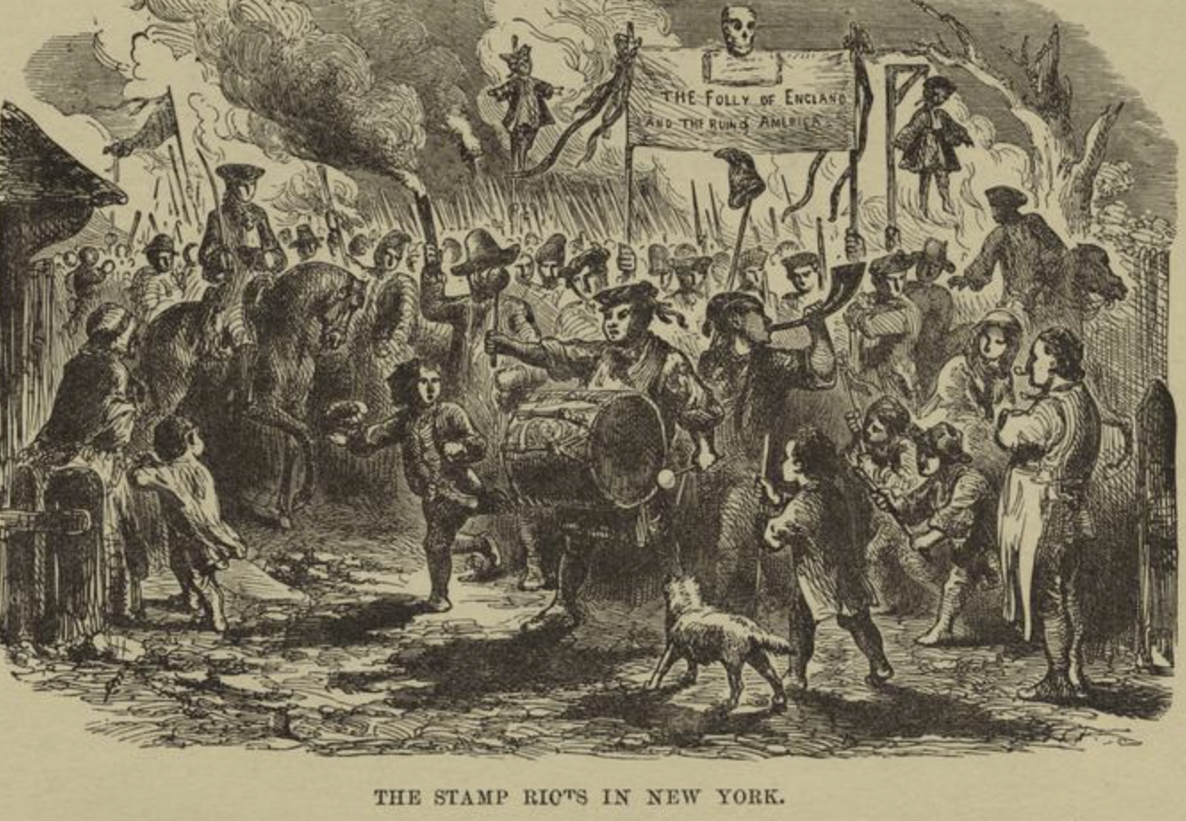
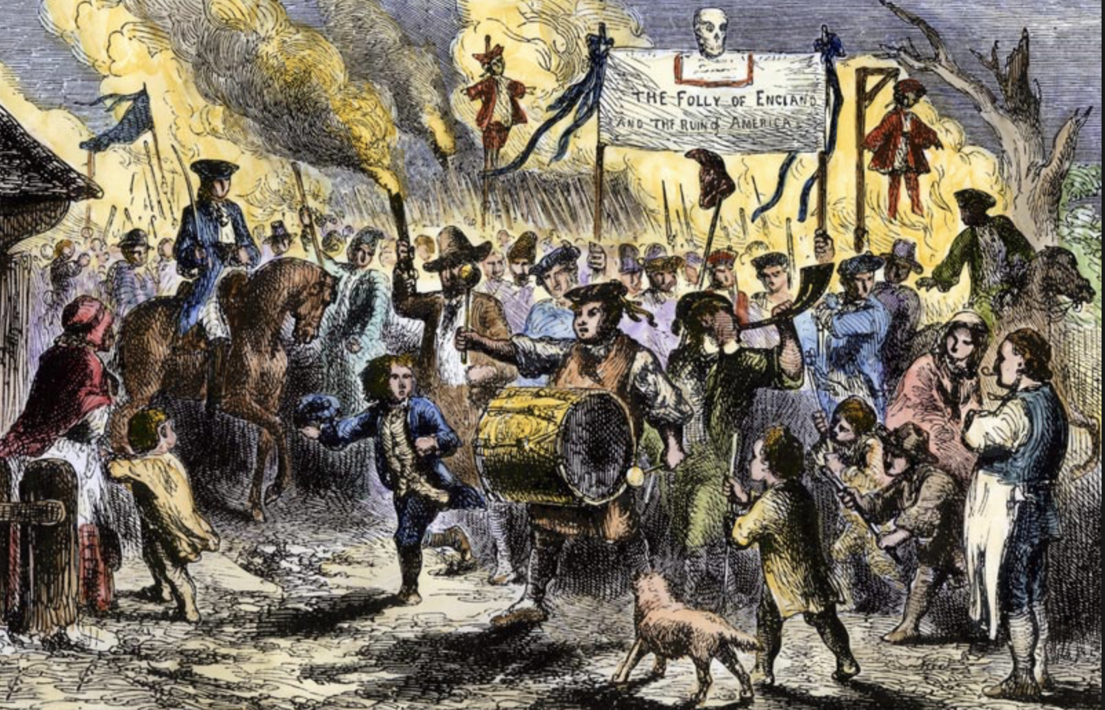
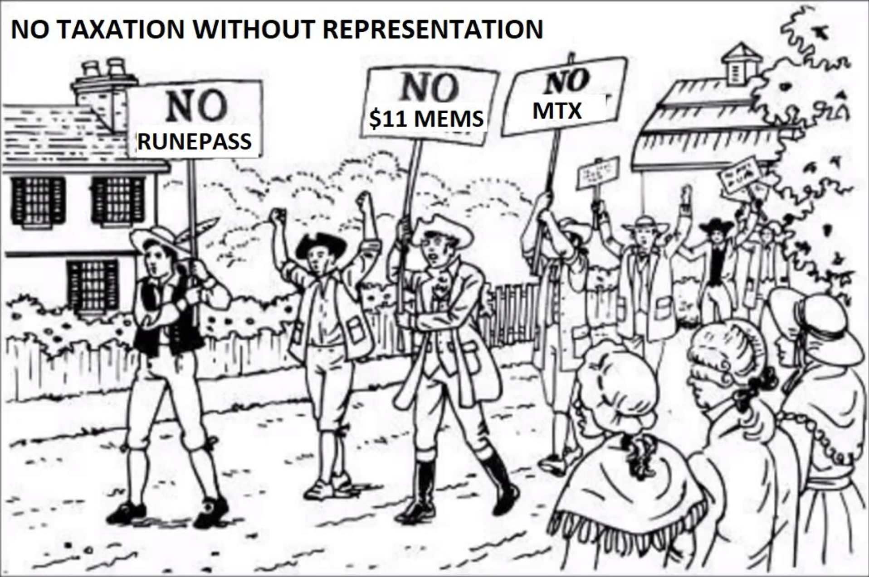

Slide 12
The First Continental Congress (1774)
The Governors of 12 out of the 13 Colonies met in September 1774 to discuss their response to British oppression
How would this meeting be viewed by King George III and the British Government?

